Slide 1
Linear Algebra and AI
By MoCo Makers
Presented by Matthew Zamora and Bill Jellesma
www.meetup.com/mocomakers

Slide 2
What is a Vector Database
https://www.youtube.com/watch?v=klTvEwg3oJ4

Slide 3
Introducing a Use Case for Vectors
https://www.youtube.com/watch?v=u47GtXwePms
RAGs - Retrieval Augmented Generation

Slide 4
Introduction To RAGs
A good longer format video -
https://www.youtube.com/watch?v=0i_7Cn31VrU

Slide 5
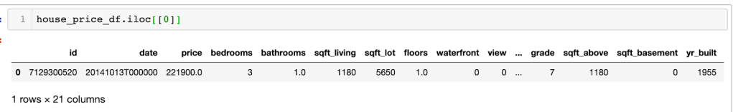
https://neptune.ai/blog/understanding-vectors-from-a-machine-learning-perspective
Key terms
Input
Model
Output
Scalar
Vector
Matrix

Slide 6
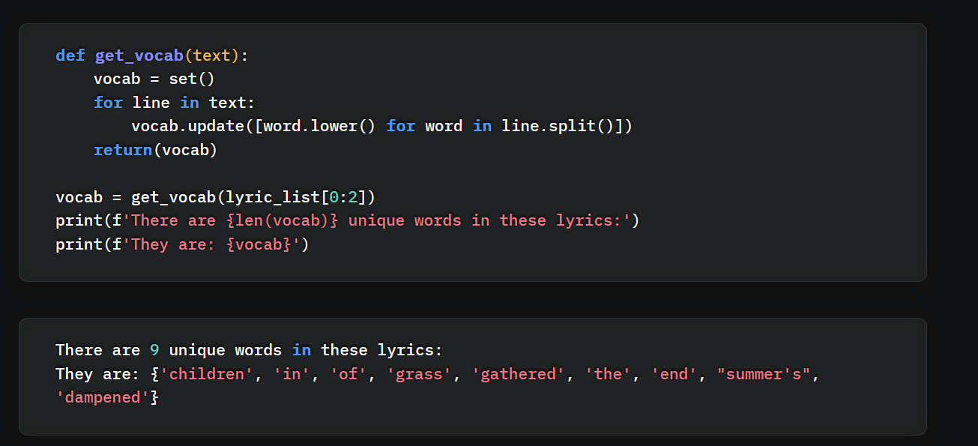
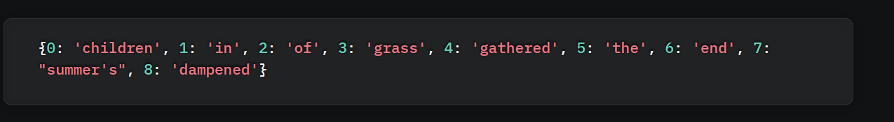
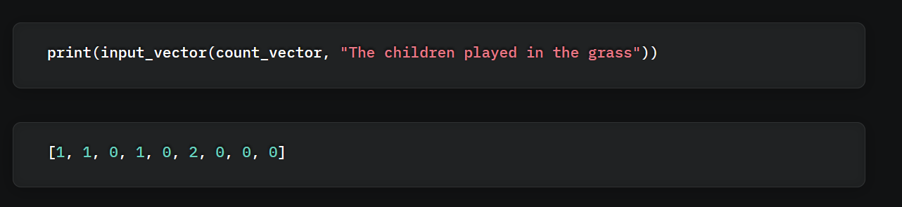
Input Vectors
Vectorization
Sparce Input Vector

Slide 7
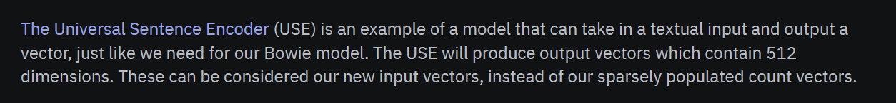
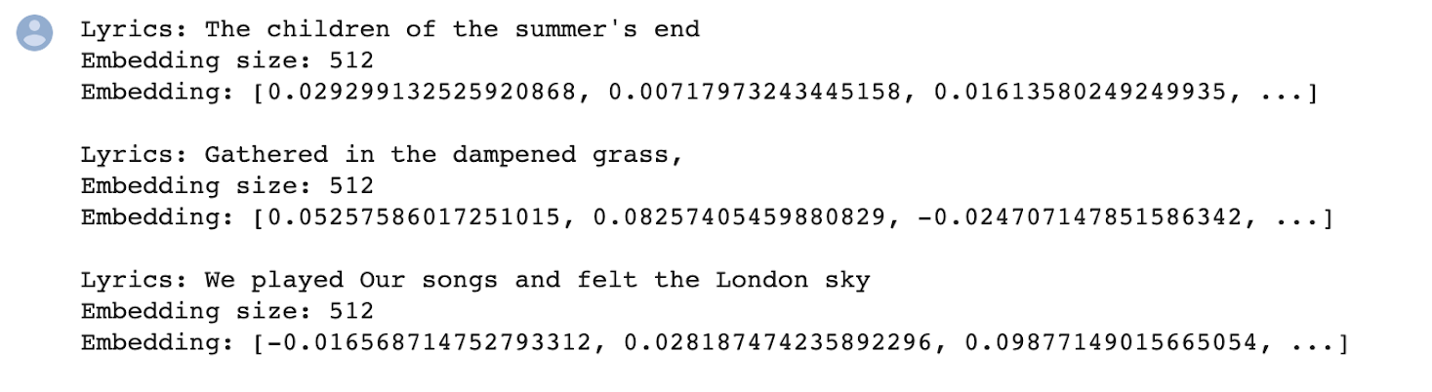
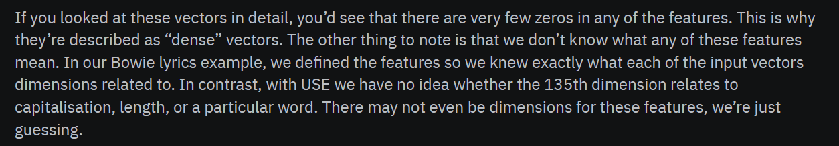
Dense Input Vector (Creating an embedding)

Slide 8
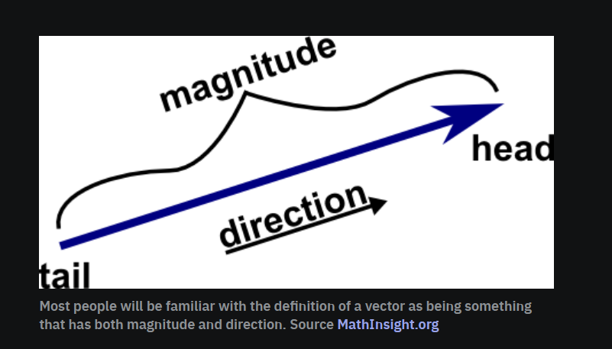
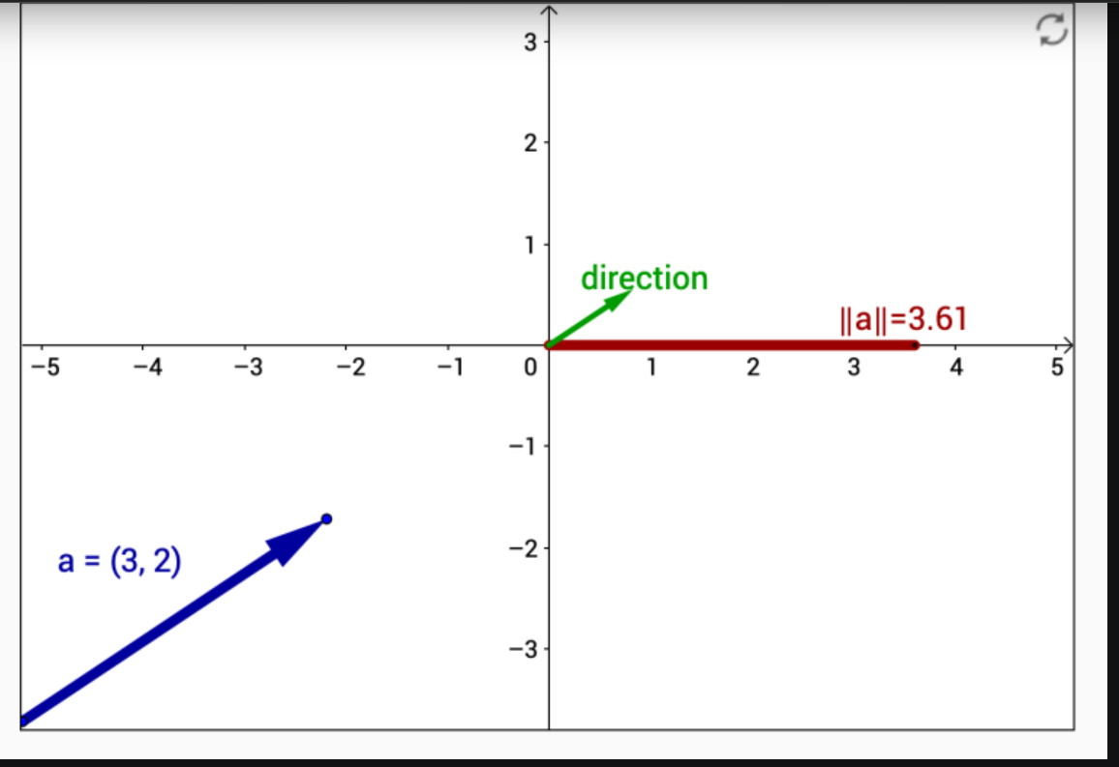
What is a Vector, again (geometrically now)

Slide 9
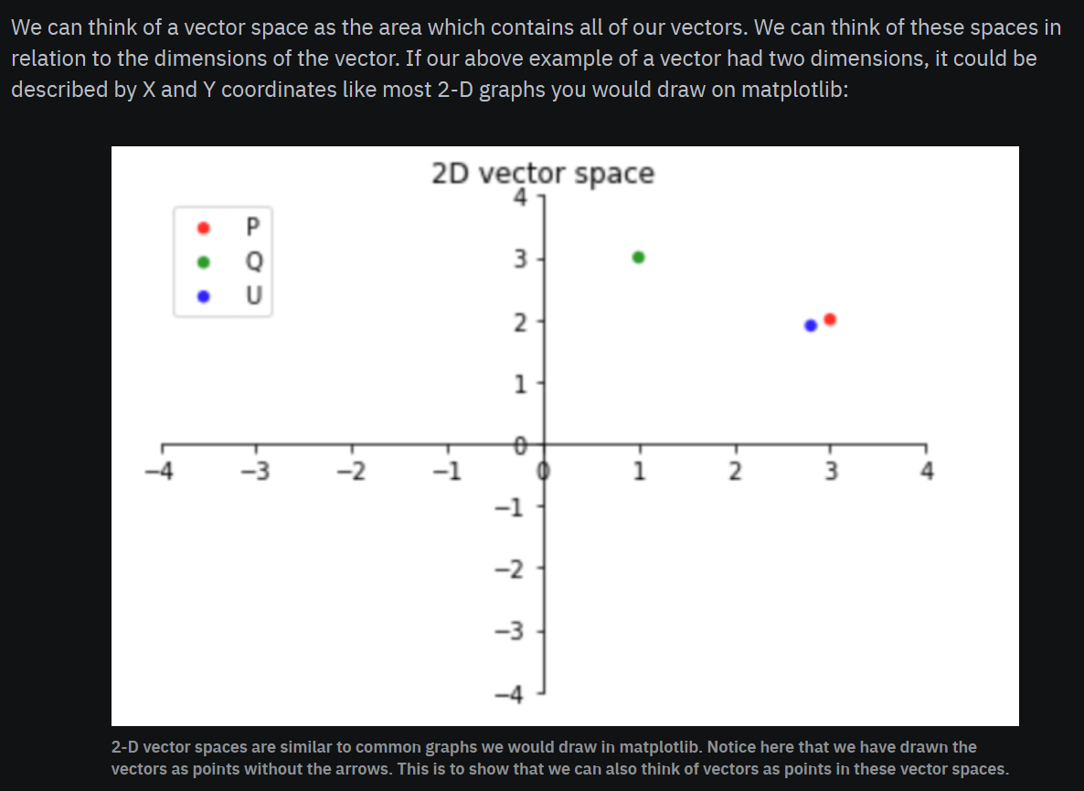
Vector Space

Slide 10
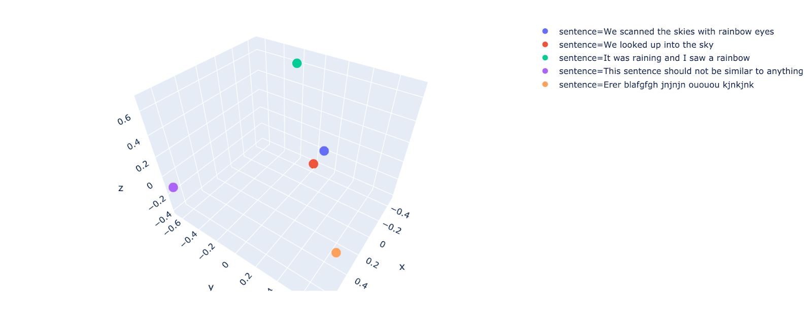
Vector Space Continued

Slide 11
Introducing Linear Algebra
https://billjellesmacoding.netlify.app/blog/20240504_linear_algebra_machine_learning
Presented by Bill Jellesma

Slide 12
How does CUDA (GPU) do a Dot Product?
https://www.youtube.com/watch?v=gB1K5S_fWKA
  Watch 1:30 – 7:51
  Warning, ultra low audio volume. Remember to turn volume down again afterwards!

