Slide 1
KISS
(Keep it simple, stupid)
Deep Learning
Convoluted Neural Networks
+ Deep Learning
- Calculus
(Disclaimer: Images/text have been taken from various sites of the internet)
Notes:
2/8/2018
1

Slide 2
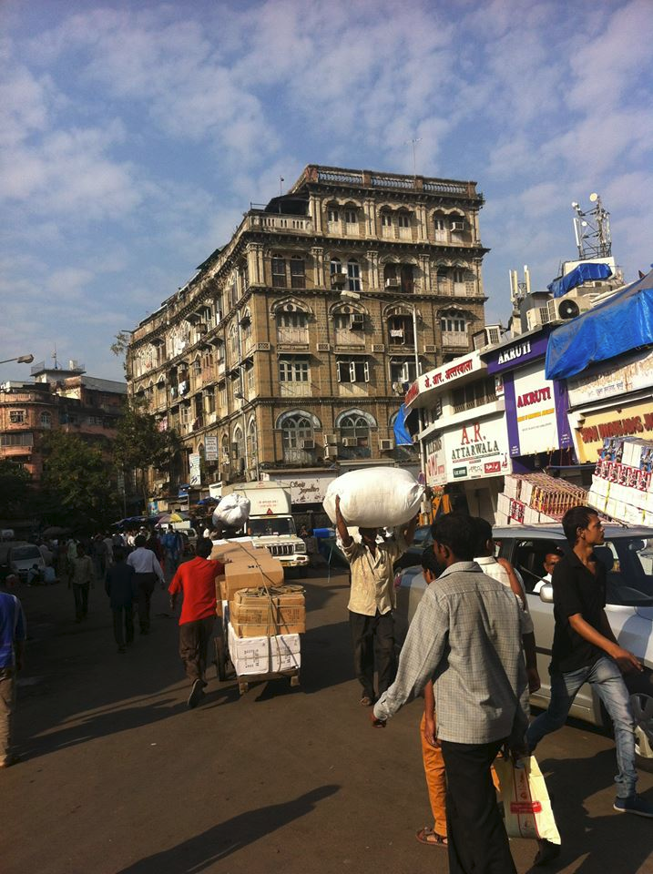

Introduction
Hello, my name is Ali.
I am from Bombay, India .
I am a Molecular Biologist, that moved into Computer Sciences.
Notes:
2/8/2018
2

Slide 3
Game 2 Move 37 The Landscape Changes
Notes:
3

Slide 4
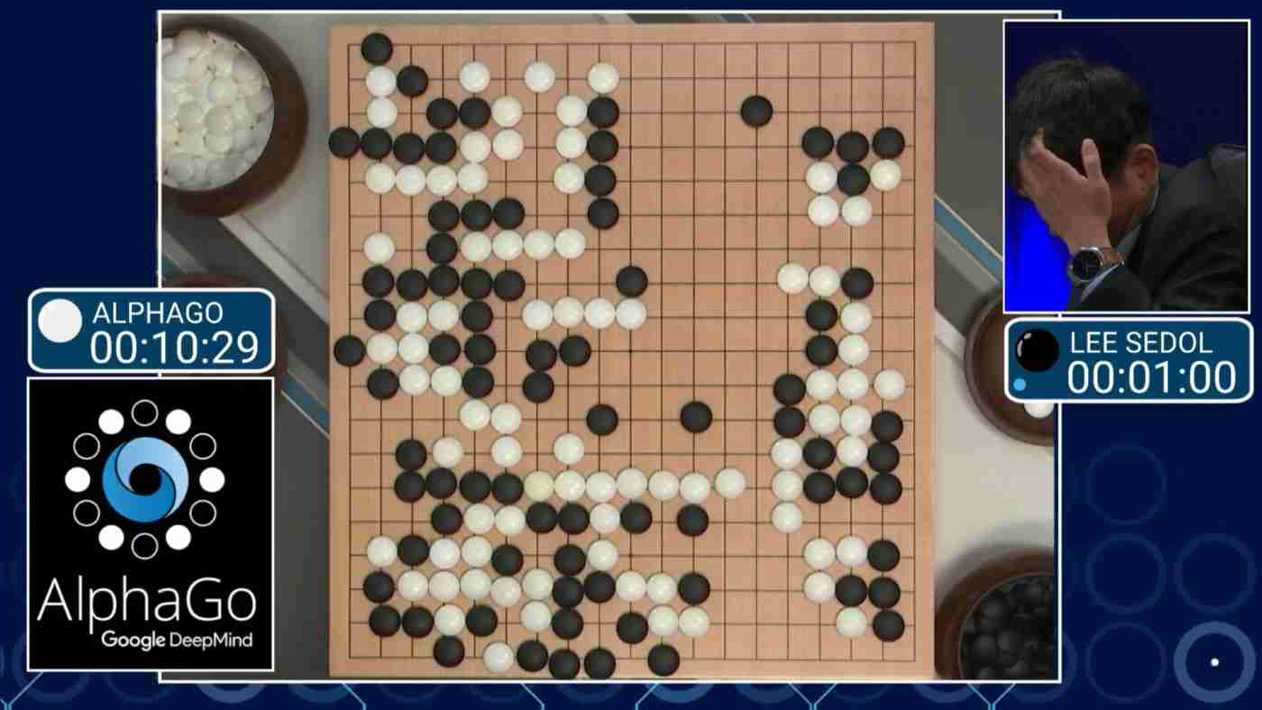
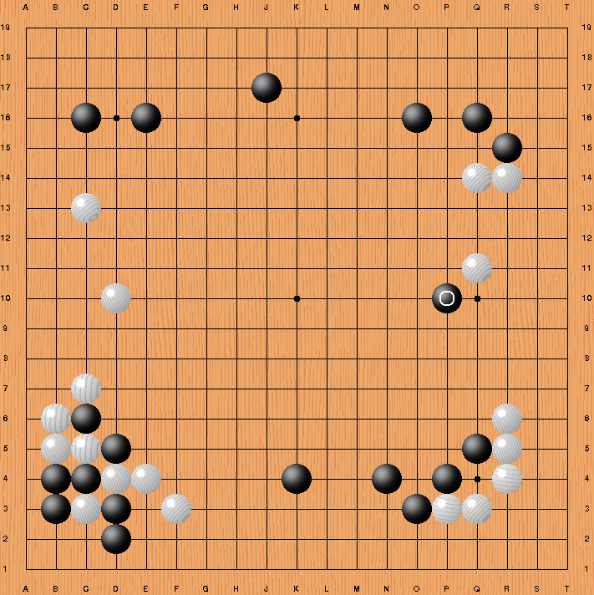
Move 37 The Landscape Changes
AlphaGo
Game 2 Move 37 March 2016
It won the game Go by defying millennia of basic human instinct.
It played this move by INTUITION(hunch), a move that had not been played by any human player in 1000’s of years of Go history.
Our takeaway, is not that Alpha DeepMind AI can learn to conquer Go, but by that extension, it can learn to conquer anything easier than Go, which amounts to a lot of things.
As Andy Salerno said “AlphaGo isnt a mysterious beast from some distant unknown planet, AlphaGo is us,
AlphaGo is our drive to push ourselves beyond what we thought possible.”
Notes:
4

Slide 5
AlphaGo Zero beats AlphaGo 100-0
Whats so different about AlphaGo Zero. ?
It mastered Go from scratch, with no human help, beyond being told the rules. It learnt to play Go, simply by playing games against itself .
Running millions of game simulations against itself, it took 40 days, for it to learn from scratch and beat AlphaGo.
What if you didn’t need clean data, but just experience, and the AI could train itself.
“Its more powerful than previous approaches, because by not using human data, or human expertise in any fashion, we removed the constraints of human knowledge and it is able to create knowledge itself” says David Silver AlphaGo’s lead researcher.
The program amasses its skill through Reinforcement Learning. When it plays a good move, it is rewarded, when it makes a bad move, it gets punished.
https://giant.gfycat.com/LazyGiddyDove.webm
Notes:
5

Slide 6
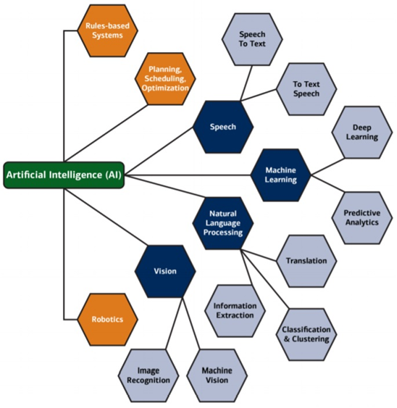
Notes:
(AI) is the ability of a machine or a computer program to think and learn.
Machine learning is a field of computer science that gives computers the ability to learn without being explicitly programmed.
Deep learning is a machine learning technique that teaches computers to learn by example.
6

Slide 7
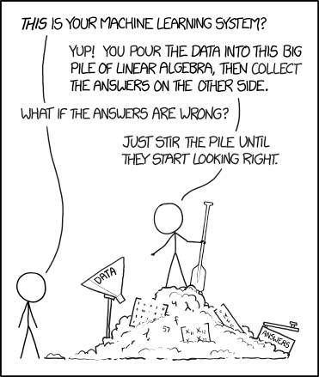

Slide 8
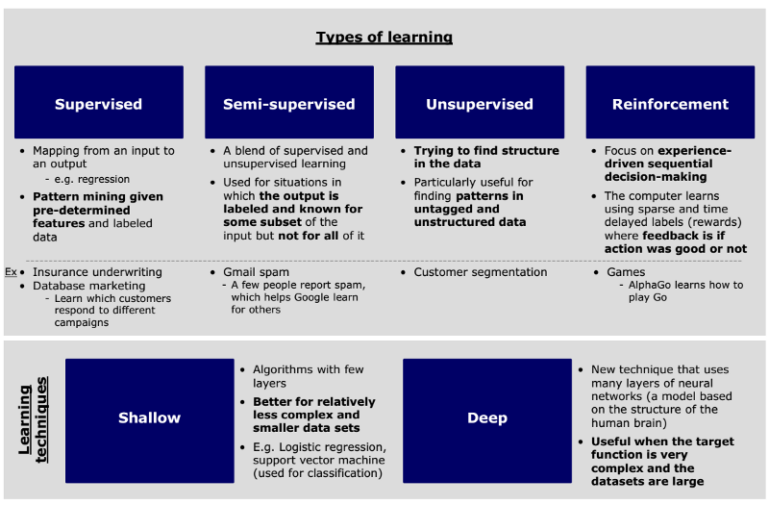
Notes:
8

Slide 9
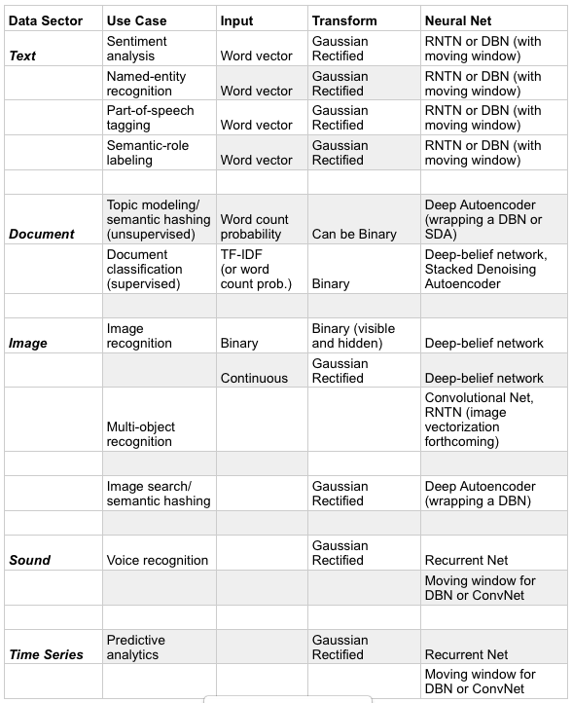
Different Types Of
Deep Learning

Slide 10
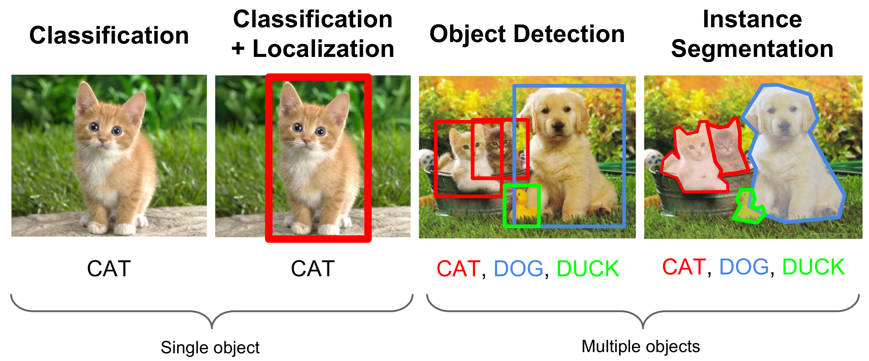
Types of Deep Learning for Images
Tonight, I will be talking about Image classification
Notes:
10

Slide 12
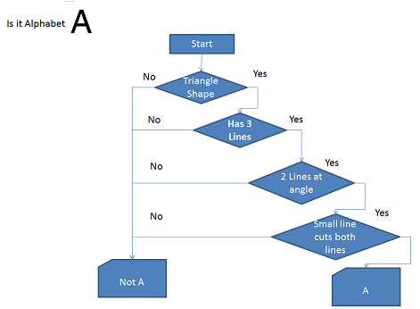
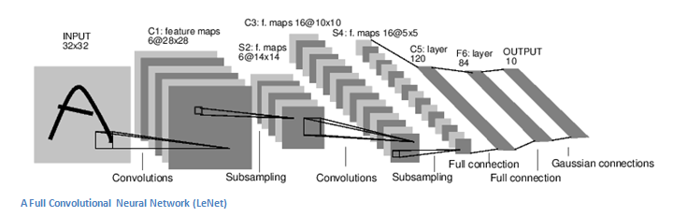
Deep Learning differs from Traditional Programming
Traditional Programming
Convolutional Neural Networks (CNNs)

Slide 13
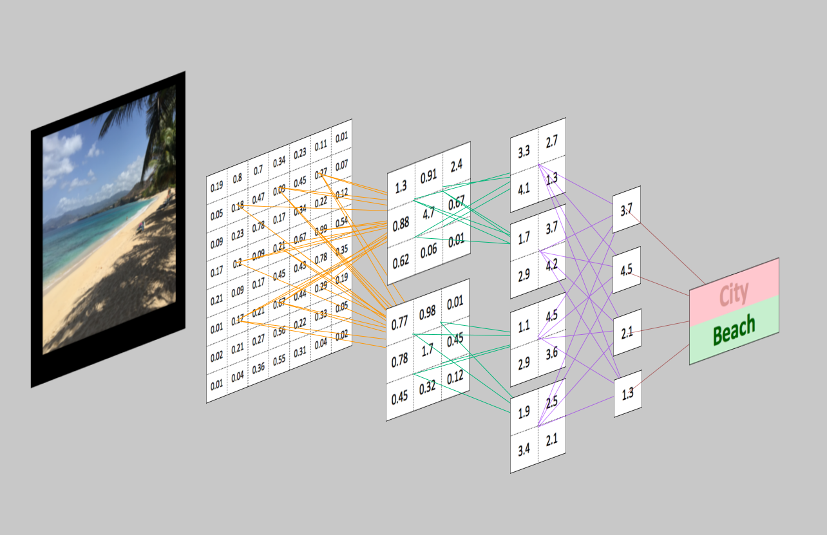
You see a Picture, the Computer sees only Numbers

Slide 14
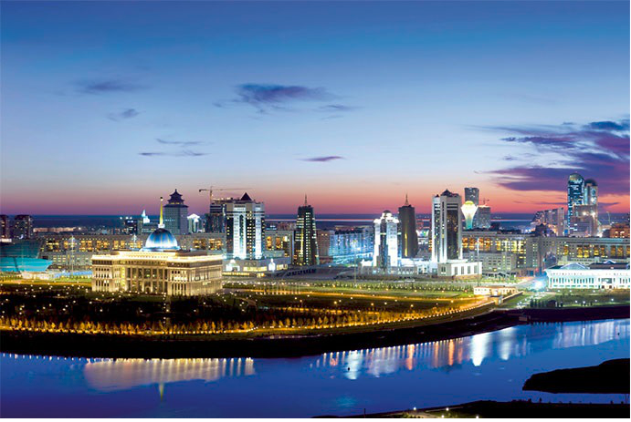
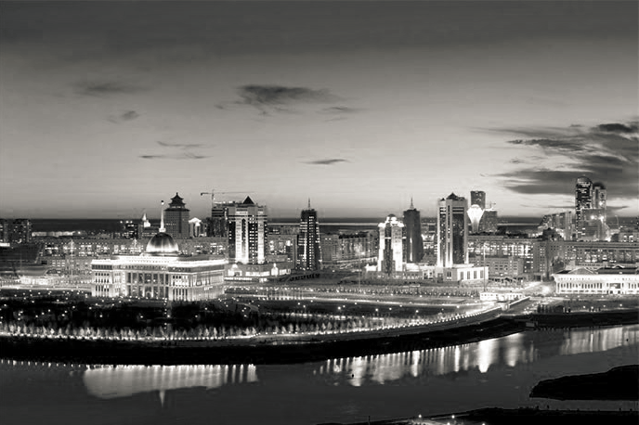
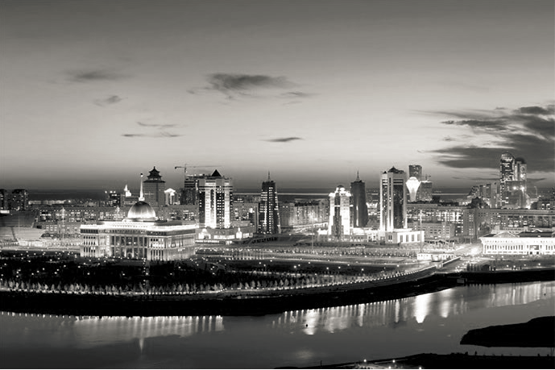
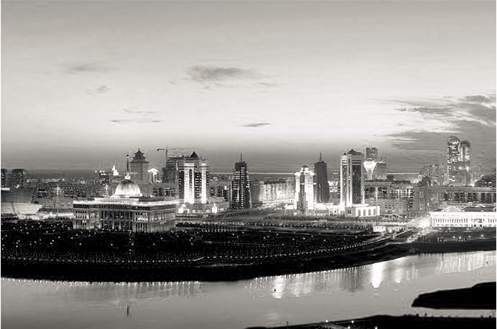
RGB Color Image
Our picture is composed of 3 layers.
Is layer has a different color channel.
Red Blue Green
Each layer has different information,
Which may not be very perceptible to us.
Our Deep learning model can extract those
Differences in Information.
Red
Green
Blue

Slide 15

Yeldos Face
50x50 Image
8 x 8 Image
RED layer Array
[[205 132 51 43 42 47 138 213]
[117 8 112 95 153 177 64 87]
[ 91 80 170 216 212 213 218 64]
[ 88 99 107 139 210 156 154 168]
[130 142 213 198 196 199 193 188]
[192 113 190 136 173 162 195 221]
[ 73 64 187 148 176 195 110 18]
[111 137 65 162 180 133 121 59]]
Green layer Array
[[210 126 26 5 3 17 120 204]
[119 0 86 56 112 143 41 72]
[ 84 60 133 168 162 169 186 41]
[ 67 64 55 77 146 100 111 133]
[102 101 155 130 126 140 147 151]
[167 78 138 74 111 109 157 193]
[ 56 37 143 94 124 151 80 0]
[ 94 109 23 109 127 90 92 41]]
Blue layer Array
[[190 112 19 2 0 6 100 175]
[ 95 0 73 49 106 133 25 51]
[ 55 36 117 156 153 158 171 23]
[ 40 44 41 66 136 87 94 113]
[ 81 83 143 119 116 124 124 124]
[147 59 125 63 98 93 136 169]
[ 36 18 130 82 113 140 69 0]
[ 78 97 11 101 121 84 88 39]]

Slide 16
Image Dataset Characteristics for CNN
Characteristics of Input Image Datasets for CNN
Same pixel count in height and width.
Same No of color channels.
Same file type.
Labelled Image Dataset.
Large No of Images.
Preferably comes from the same Data Source.
The Dataset can be broken down into: ( one can be somewhat flexible)
            Training Dataset(80%)
            Validation Dataset (15%)
            Test Dataset (5%)
Notes:
16

Slide 17
Toolset
Tensorflow 1.5 ( includes Keras Libraries)
Python 3.6
OpenCV
Anaconda
Jupyter Notebooks
Windows environment
Optional GPU Card ( CPU will slow down dramatically)

Slide 19
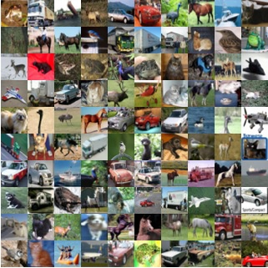
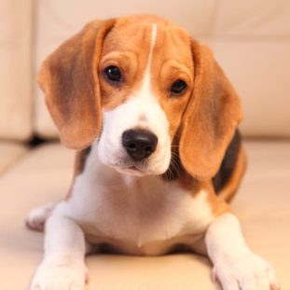
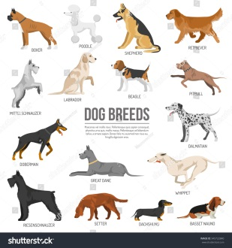
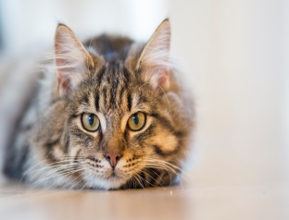
The Problem Statement
We are given a collection of images of Dogs and Cats,
Our Task is to separate these pictures into Dog and Cat folders
We want to Extract Dog pictures according to their breed.
You have a labeled Dog and Cat image Dataset.
You have a Stanford Dogs Breed Dataset.
How will we do it ?
Notes:
19

Slide 20
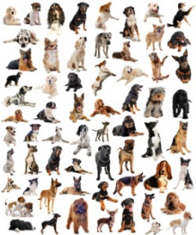
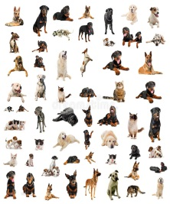
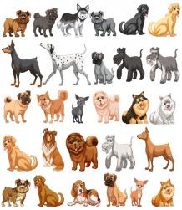
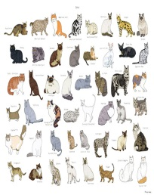
Method 1: How we are going to solve this. Step 1.
Cleaned Labeled
Training Data Set
Of Dogs and Cats
Random
Image Collection
Image
Preprocessor
Data
Augmentation
Dog_Cat
Trained Model
Train
CNN
Dog_Cat
Model
Dogs
Cats
HyperParameters Tuning
Loss Function should Decrease
Accuracy should Increase
Watch out for Underfitting and Overfitting
Confusion Matrix

Slide 21
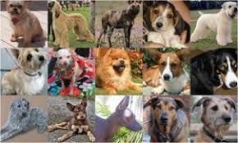
Method 1: How we are going to solve this Step 2.
Stanford Dogs Set
Dogs Directory
Image
Preprocessor
Data
Augmentation
DogBreeds
Trained Model
Train
CNN
DogBreeds
Model
Affenpinscher
Akita
Pug
HyperParameters Tuning
Loss Function should Decrease
Accuracy should Increase
Watch out for Underfitting and Overfitting
Confusion Matrix

Slide 22
Method 2: How we are going to solve this Task. Step 1
Transfer Learning
Pre Trained Model
VGG16
Random
Image Collection
Dogs
Cats

Slide 23
Method 1: How we are going to solve this Step 2.
Stanford Dogs Set
Transfer Learning
Dogs Directory
Pre Trained Model
VGG16
Image
Preprocessor
ReTrain the Lower Layers of the
VGG16 Model
Affenpinscher
Akita
Pug

Slide 25
ConvNets
Its an Artificial Neural Net, inspired by our Visual Cortex.
Very good Performance on Computer Vision/Images.
It takes an Image, passes it thru a series of Convolution Layers, non linear Activation layers, Pooling layers, Fully Connected layer to output the classification labels.
It starts by looking at low level features, such as lines, edges, curves, then builds on more abstract features.
During the Learning process, the network learns individual parts of an object, and adds them up to build abstract features.

Slide 26
Basic CNN Architecture
CNN Black Box
…
Input
Layer
Convolution
Layer
Pooling
Layer
Fully
Connected
Layer
INPUT
Output
Activation Function (ReLU)
Notes:
26

Slide 27
CNN Model, (we are going to use)
Input
Image
50
3 x 3
Conv
Stride=1
Relu
48
Dog
2x2
MaxPool
Cat
32
Channels
50
48
Flatten
Fully
connected
Output
Layer
Notes:
27

Slide 28
DATASET
Original Dataset
Training Dataset (80%)
Validation Dataset (20%)
Batch Size
Model
In Training
EPOCH
Training Loss
Training Accuracy
Validation Loss
Validation Accuracy
Notes:
28

Slide 29
Convnets Definitions
Epoch
Number of epochs is the the number of times the entire training set pass through the neural network. We should increase the number of epochs until we see a small gap between the test error and the training error.
Batch size
Mini-batch is usually preferable in the learning process of convnet. A range of 16 to 128 is a good choice to test with. We should note that convnet is sensitive to batch size.
Activation function
Activation funtion introduces non-linearity to the model. Usually, rectifier works well with convnet. Other alternatives are sigmoid, tanh and other activation functions depening on the task.
Learning rate
Learning rate controls how much to update the weight in the optimization algorithm

Slide 30
Training Accuracy/ Training Loss
Train accuracy and train loss are calculated on the go, during training. These figures show how well your network is doing on the data it is being trained. Training accuracy usually keeps increasing throughout training.
Validation Accuracy/Validation Loss
After every epoch, your model is tested against a validation set, and validation loss and accuracy are calculated. These numbers tell you how good your model is at predicting outputs for inputs it has never seen before.
Loss value implies how well or poorly a certain model behaves after each iteration of optimization. Ideally, one would expect the reduction of loss after each, or several, iteration(s).
if validation accuracy is lower than training accuracy , then we are overfitting.

Slide 31
OverFitting UnderFitting
OverFitting (Validation Accuracy < Traning Accuracy )
Increase Dropout
Use Regularization
Early Stopping
Underfitting (very low Traning Accuracy)
Add More Data
Data Augmentation
Use More Complex Model.
Notes:
31

Slide 32
Transfer Learning
Transfer learning,
is storing knowledge gained while solving one problem,
and
applying it to a different but related problem.
Why use Transfer Learning.
Training a Model, from scratch, requires lot of input data.
Very deep networks are very resource and cash expensive.
Determining the topology, hyperparameters is black magic.

Slide 33
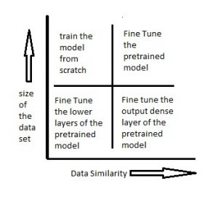
Transfer Learning Notes

Slide 34
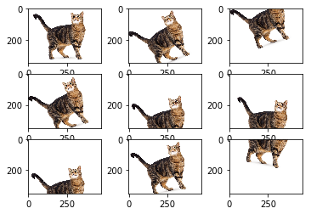
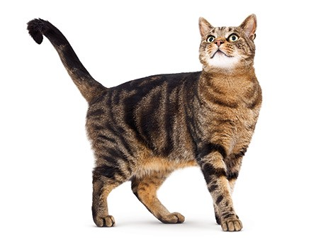
Data Augmentation ( in our case the Data is an image)
Data Augmentation
Artificially creates training images through different ways of processing or combination of multiple processing, such as random rotation, shifts, shear and flips, etc.
This enlarges the training set and helps in avoiding overfitting.

Slide 35
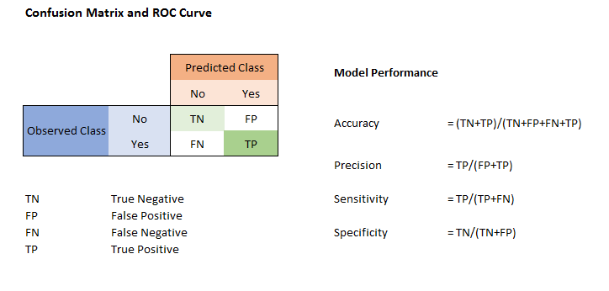
Confusion Matrix for Classification
Notes:
35

Slide 36
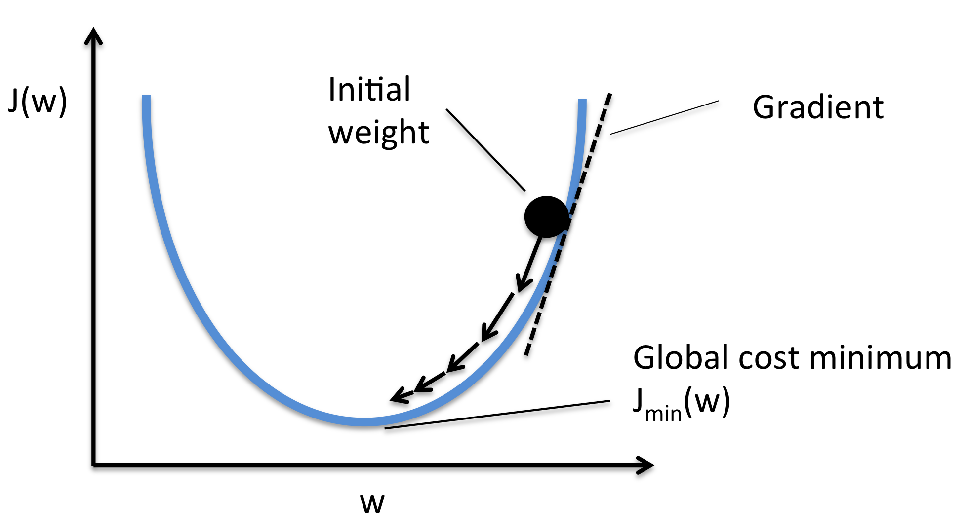
At the end of the day. Its all about the Gradient Descent and finding the Minima.

Slide 37
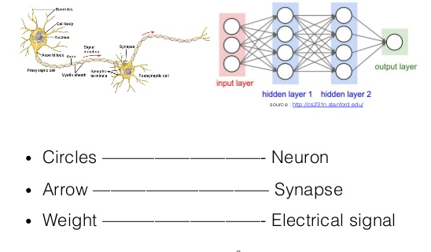
Convoluted Neural Network:- Visual Cortex
The CNN takes inspiration from the layered structure of the brain’s visual cortex.
In CNNs and the human visual cortex alike, the image flows through a deep hierarchy of neural layers of simultaneously growing specificity and abstraction.
At the network’s input, neurons notice small details like edges, transmitting information into a second layer
that processes corners, and then into a layer that detects specific combinations of previous features, and so on.
At the output of the network one can find “grandmother neurons,” each of which signals the presence of a particular kind of object.
Notes:
37

Slide 38
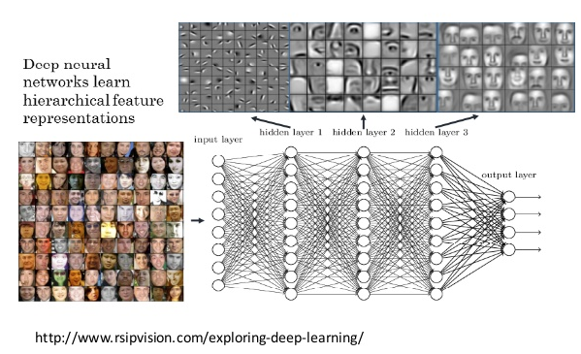
How a CNN perceives an Image

Slide 39
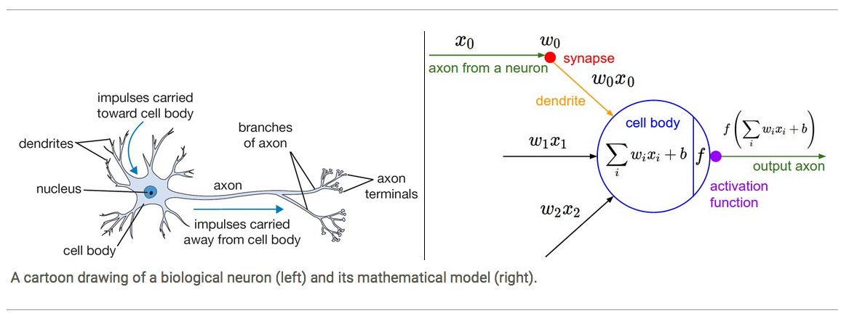
How to imitate the Neuron
Notes:
Individual nodes in a Neural network emulate the biological neurons, by taking input data and performing simple operations on data, and selectively passing the results on to other neurons.
The output of each neuron is called an Activation.
39

Slide 40
Components of a NODE
Inputs
Weights
Bias
Activation Function
Output
Notes:
Explain what these terms are with examples
40

Slide 41
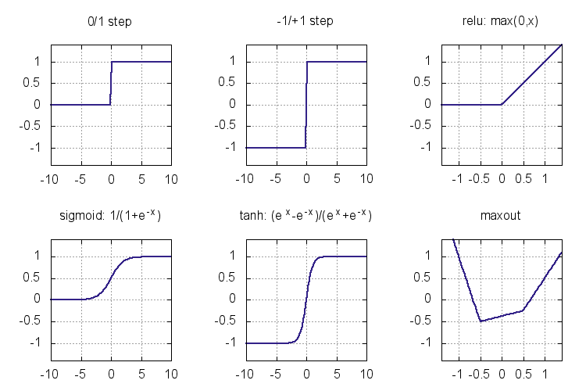
Activation Functions
Notes:
How they relate to a Synapse
What are they and which one to use
Activation functions are functions which take an input signal and convert it to an output signal. Activation functions introduce non-linearity to the networks
What does an artificial Neuron do, it calculates a weighted sum of its inputs , adds a bias and then decides whether it should be fired or not.
Y = Sum( weights * inputs) + bias
Here the Neuron does not know the bounds of the value, ( -infinity/+infinity), the question is, how do we decide to fire the neuron or not.
Give an example: Hold a chocolate holding it out to the class, somebody will come and take it, that’s an eg of a neuron firing.
The Step Function
It has outputs 0 ( not activated) / 1 (activated). One may think that’s perfect, the neuron fires or does not fire.
It has its limitations, if the neuron fires, then all neurons attached to it fire as well.
Useful for Binary Classifications.
SIGMOID
Its Non linear, used a lot, activations are range bound (0,1)
Vanishing gradients, towards the end of the sigmoid function, than the network refuses to learn, becomes very slow in converging
Not Zero centered
TanH
Very similar to the Sigmoid the gradient is stronger than Sigmoid and range bound ( -1,1)
Zero centered
Vanishing gradient problem,
ReLu ( Rectified Linear Units)
Looks like a linear function, in the positive axis range is ( 0,infinity)
Computationally less expensive, but for gradients -> 0 , the weights will not get updated, and those neurons will not fire, and will stop responding to their inputs.
This is the Dying ReLu problem, where a part of the network can become passive. ( to overcome we use Leaky ReLu)
Used only in Hidden Layers not to be used in output layer.
Nb: the gradient of the sigmid function vanishes as we increase or decrease x, RELU gradient does not vanish as we increase x.
Leaky ReLu ( leaky Linear Units)
Allow a small non zero gradient. Range is (-infinity, Infinity)
One of the ways to fix the dying ReLu problem
41

Slide 42
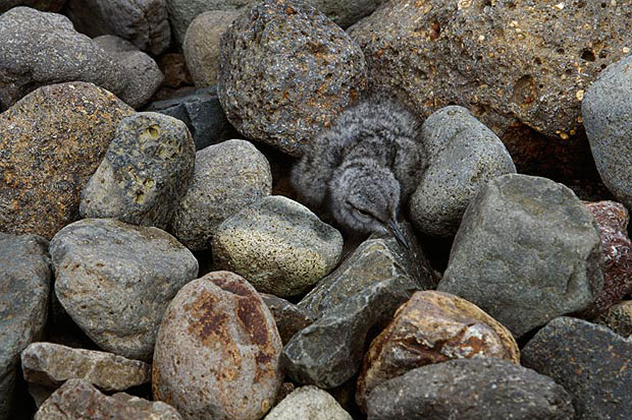
Softmax Classifier Function
What do you see ?
RAT
MARBLE
ROCKS
BIRD
WATER
Notes:
SoftMax
Used for classification in the outer layer, because it provides a probability for different classes.
Practical eg
Hold something in the hand and ask them to classify it in different classes.
42

Slide 44
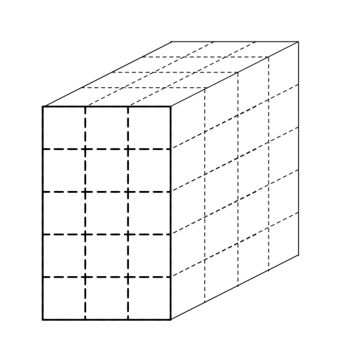
Input Layer
Input Layers
Input layers are where we load and store the raw input data of the image for processing in the network.
This input data specifies the width, height, and number of channels.
Typically, the number of channels is three, for the RGB values for each pixel.
In our case of the Astana Landscape jpeg, it has 3 layers
“Red Layer”
“Green Layer”
“Blue Layer”

Slide 45
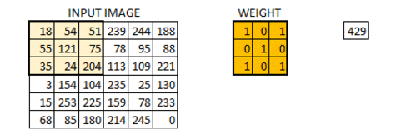
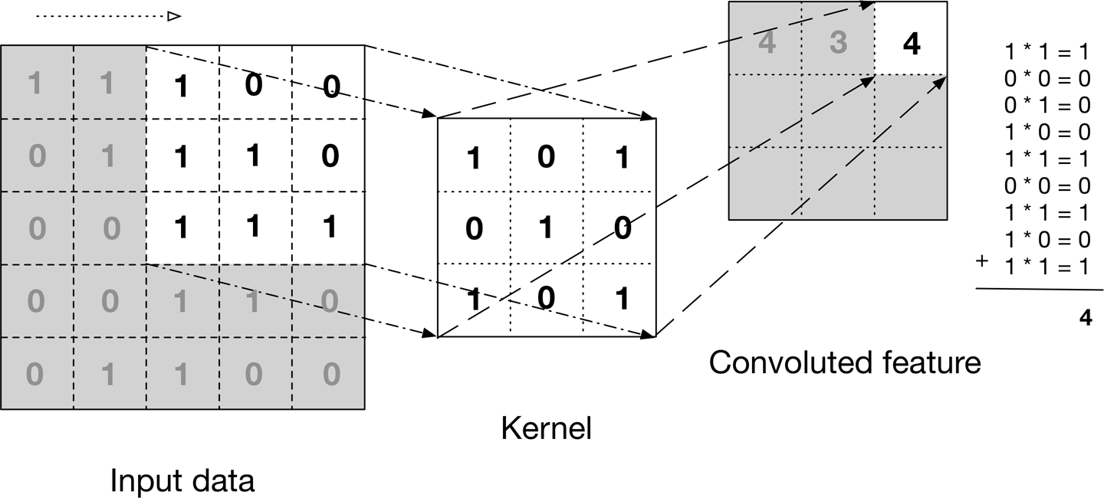
Convolution Layer
The convolution operation, is known as the feature detector of a CNN.
The sets of weights in a convolution layer is the filter or kernel.
Convolution preserves the spatial relationship between pixels by learning image features using small squares of input data
In practice, a CNN learns the values of these filters on its own during the training process.
The more number of filters we have, the more image features get extracted and the better our network becomes at recognizing patterns in unseen images.
.

Slide 46
The size of the Convoluted Feature is controlled by three parameters, that are predecided.
Depth:
Number of filters used for the convolution operation.
Stride:
Stride is the number of pixels by which we slide our filter matrix over the input matrix.
When the stride is 1 then we move the filters one pixel at a time.
When the stride is 2, then the filters jump 2 pixels at a time as we slide them around.
Having a larger stride will produce smaller feature maps.
Zero-padding:
We pad the input matrix with zeros around the border, so that we can apply the filter to bordering elements of our input image matrix.
A nice feature of zero padding is that it allows us to control the size of the feature maps.
Adding zero-padding is also called wide convolution, and not using zero-padding would be a narrow convolution.

Slide 47
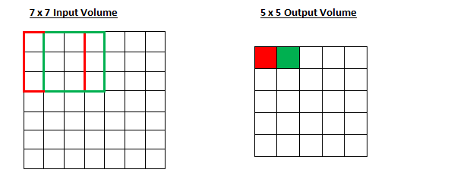
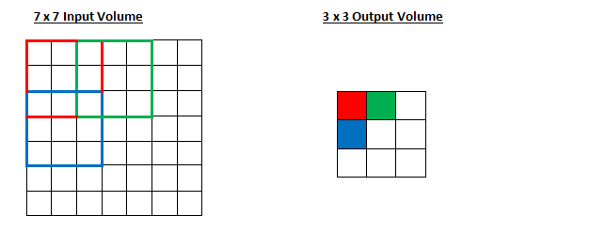
Stride controls how the filter convolves around the input volume.
Stride is normally set in a way so that the output volume is an integer and not a fraction.
Input= 7x7
Depth=1
Stride = 1
Filter = 3x3
Padding = 0
Output=5x5
Input = 7x7
Depth=1
Stride = 2
Filter = 3x3
Padding =0
Output = 3x3

Slide 48

Calculate the Output Size from predefined Parameters
O : Output height/length
W : Input height/length
K ; Filter size
P : Zero padding
S : Stride.
Question ?
Input Image is 7 x7
Stride = 1
Filter Size =3
I want my Output to be 7x7
What would you do ?
W = 7
K = 3
P =0
S=1
O = ((7 – 3 + 2*0) /1 ) +1
O = 5

Slide 49
Calculate the Output Size from predefined Parameters
O : Output height/length
W : Input height/length
K ; Filter size
P : Zero padding
S : Stride.
Question ?
Input Image is 7 x7
Stride = 1
Filter Size =3
I want my Output to be 7x7
Answer:
Add Zero Padding
7 = ((7-3 + 2P)/1)+1
7 = (4+ 2P) + 1
6 = 4 + 2P
P = (6-4)/2 = 1
W = 7
K = 3
P =0
S=1
O = ((7 – 3 + 2*0) /1 ) +1
O = 5

Slide 50
Activation Function Layer
After each convolution layer, we apply a nonlinear layer (or activation layer).
The purpose of this layer is to introduce non-linearity to a system that basically has just been computing linear
operations during the convolution layers, since most of the real-world data we would want our ConvNet to learn would be non-linear.
We will be using ReLU ( Rectified Linear Unit).
ReLU is an element wise operation (applied per pixel) and replaces all negative pixel values in the feature map by zero.
Other non linear functions such as tanh or sigmoid can also be used instead of ReLU, but ReLU has been found to perform better in most situations.

Slide 51
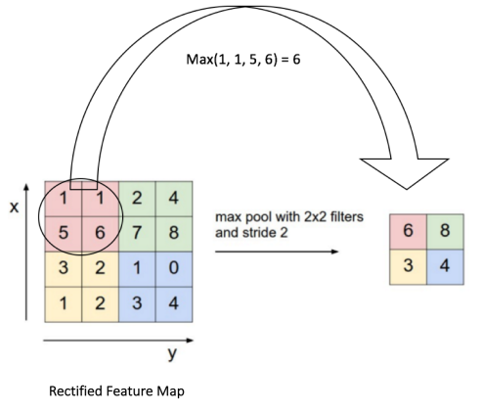
Pooling Layer
Pooling (subsampling) reduces the dimensionality of each feature map but retains the most important information.
Spatial Pooling can be of different types: Max, Average, Sum etc.
In our case of Max Pooling, we have defined a 2×2 window.
We take the largest element from the rectified feature map within that window.
Instead of taking the largest element we could also take the average (Average Pooling) or sum of all elements in that window.
In practice, Max Pooling has been shown to work better.

Slide 52
Benefits of Pooling
The function of Pooling is to progressively reduce the spatial size of the input representation.
In particular, pooling
Makes the input representations (feature dimension) smaller and more manageable.
Reduces the number of parameters and computations in the network, therefore, controlling overfitting.
Makes the network invariant to small transformations, distortions and translations in the input image.
(a small distortion in input will not change the output of Pooling – since we take the max / avg value in a local neighborhood).
Helps us arrive at an almost scale invariant representation of our image (the exact term is “equivariant”).
This is very powerful since we can detect objects in an image no matter where they are located .

Slide 53
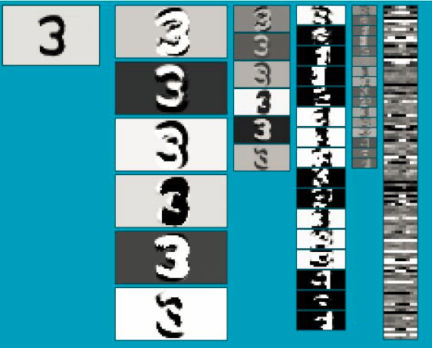
Input
C
P
C
P
C
C
Convolution Layer
P
Pooling Layer

Slide 54
Fully Connected Layer
The Fully Connected layer is a traditional Multi Layer Perceptron that uses a softmax activation function in the output layer
Every neuron in the previous layer is connected to every neuron on the next layer.
The output from the convolutional and pooling layers represent high-level features of the input image.
The purpose of the Fully Connected layer is to use these features for classifying the input image
into various classes based on the training dataset.
Apart from classification, adding a fully-connected layer is also a cheap way of learning non-linear combinations of these features.
Most of the features from convolutional and pooling layers may be good for the classification task, but combinations of those features might be even better.
The sum of output probabilities from the Fully Connected Layer is 1.
This is ensured by using the Softmax as the activation function in the output layer of the Fully Connected Layer.
The Softmax function takes a vector of arbitrary real-valued scores and squashes it to a vector of values between zero and one that sum to one.

Slide 55
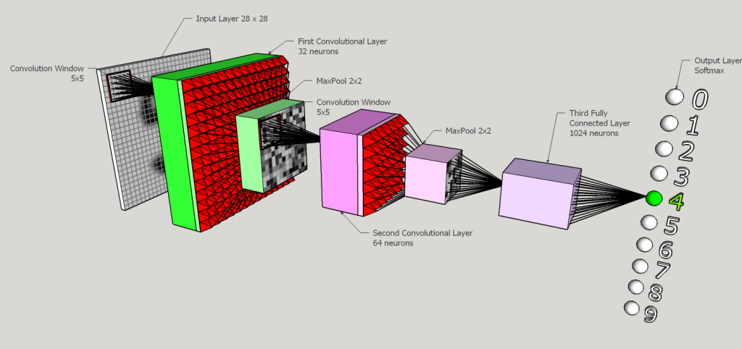

Slide 56
Training a Convoluted Neural Network
Step1: We initialize all filters and parameters / weights with random values.
Step2: The network takes a training image as input, goes through the forward propagation step (convolution, ReLU and pooling operations along with forward propagation in the Fully Connected layer) and finds the output probabilities for each class.
Lets say the output probabilities for the “4” image above are [0.2,0.0,0.0, 0.1, 0.3, 0.1,0.0,0.1,0.1,0.1]
Since weights are randomly assigned for the first training example, output probabilities are also random.
Step3: Calculate the total error at the output layer (summation over all 10 classes)
Total Error = ∑ ½ (target probability – output probability) ²
Step4: Use Backpropagation to calculate the gradients of the error with respect to all weights in the network and use gradient descent to update all filter values / weights and parameter values to minimize the output error.
The weights are adjusted in proportion to their contribution to the total error.
When the same image is input again, output probabilities might now be
[0.1,0.0,0.0, 0.1, 0.7, 0.0,0.0,0.0,0.0,0.1], which is closer to the target vector [0, 0,0,0, 1, 0,0,0,0,0].
This means that the network has learnt to classify this particular image correctly by adjusting its weights / filters such that the output error is reduced.
Step5: Repeat steps 2-4 with all images in the training set.

Slide 58
We all can help drive Discoveries
Teenagers who used Machine Learning, and made a change.
https://techcrunch.com/2017/08/03/high-schooler-makes-3d-printed-machine-learning-powered-eye-disease-diagnosis-system/
http://www.businessinsider.com/google-showcases-teen-programmer-helping-diagnose-cancer-2017-5
https://qz.com/920091/a-west-virginia-teen-taught-himself-how-to-build-a-rapping-ai-using-kanye-west-lyrics/
http://mashable.com/2017/07/28/16-year-old-ai-genius/#7RErBIInViqQ
Notes:
2/8/2018
58

Slide 59
Contact Details
Email: aliasgertalib@gmail.com
Linkedin: https://www.linkedin.com/in/aliasgertalib

