Slide 1
Raspberry Pi
Cluster Using Apache Spark

Slide 2
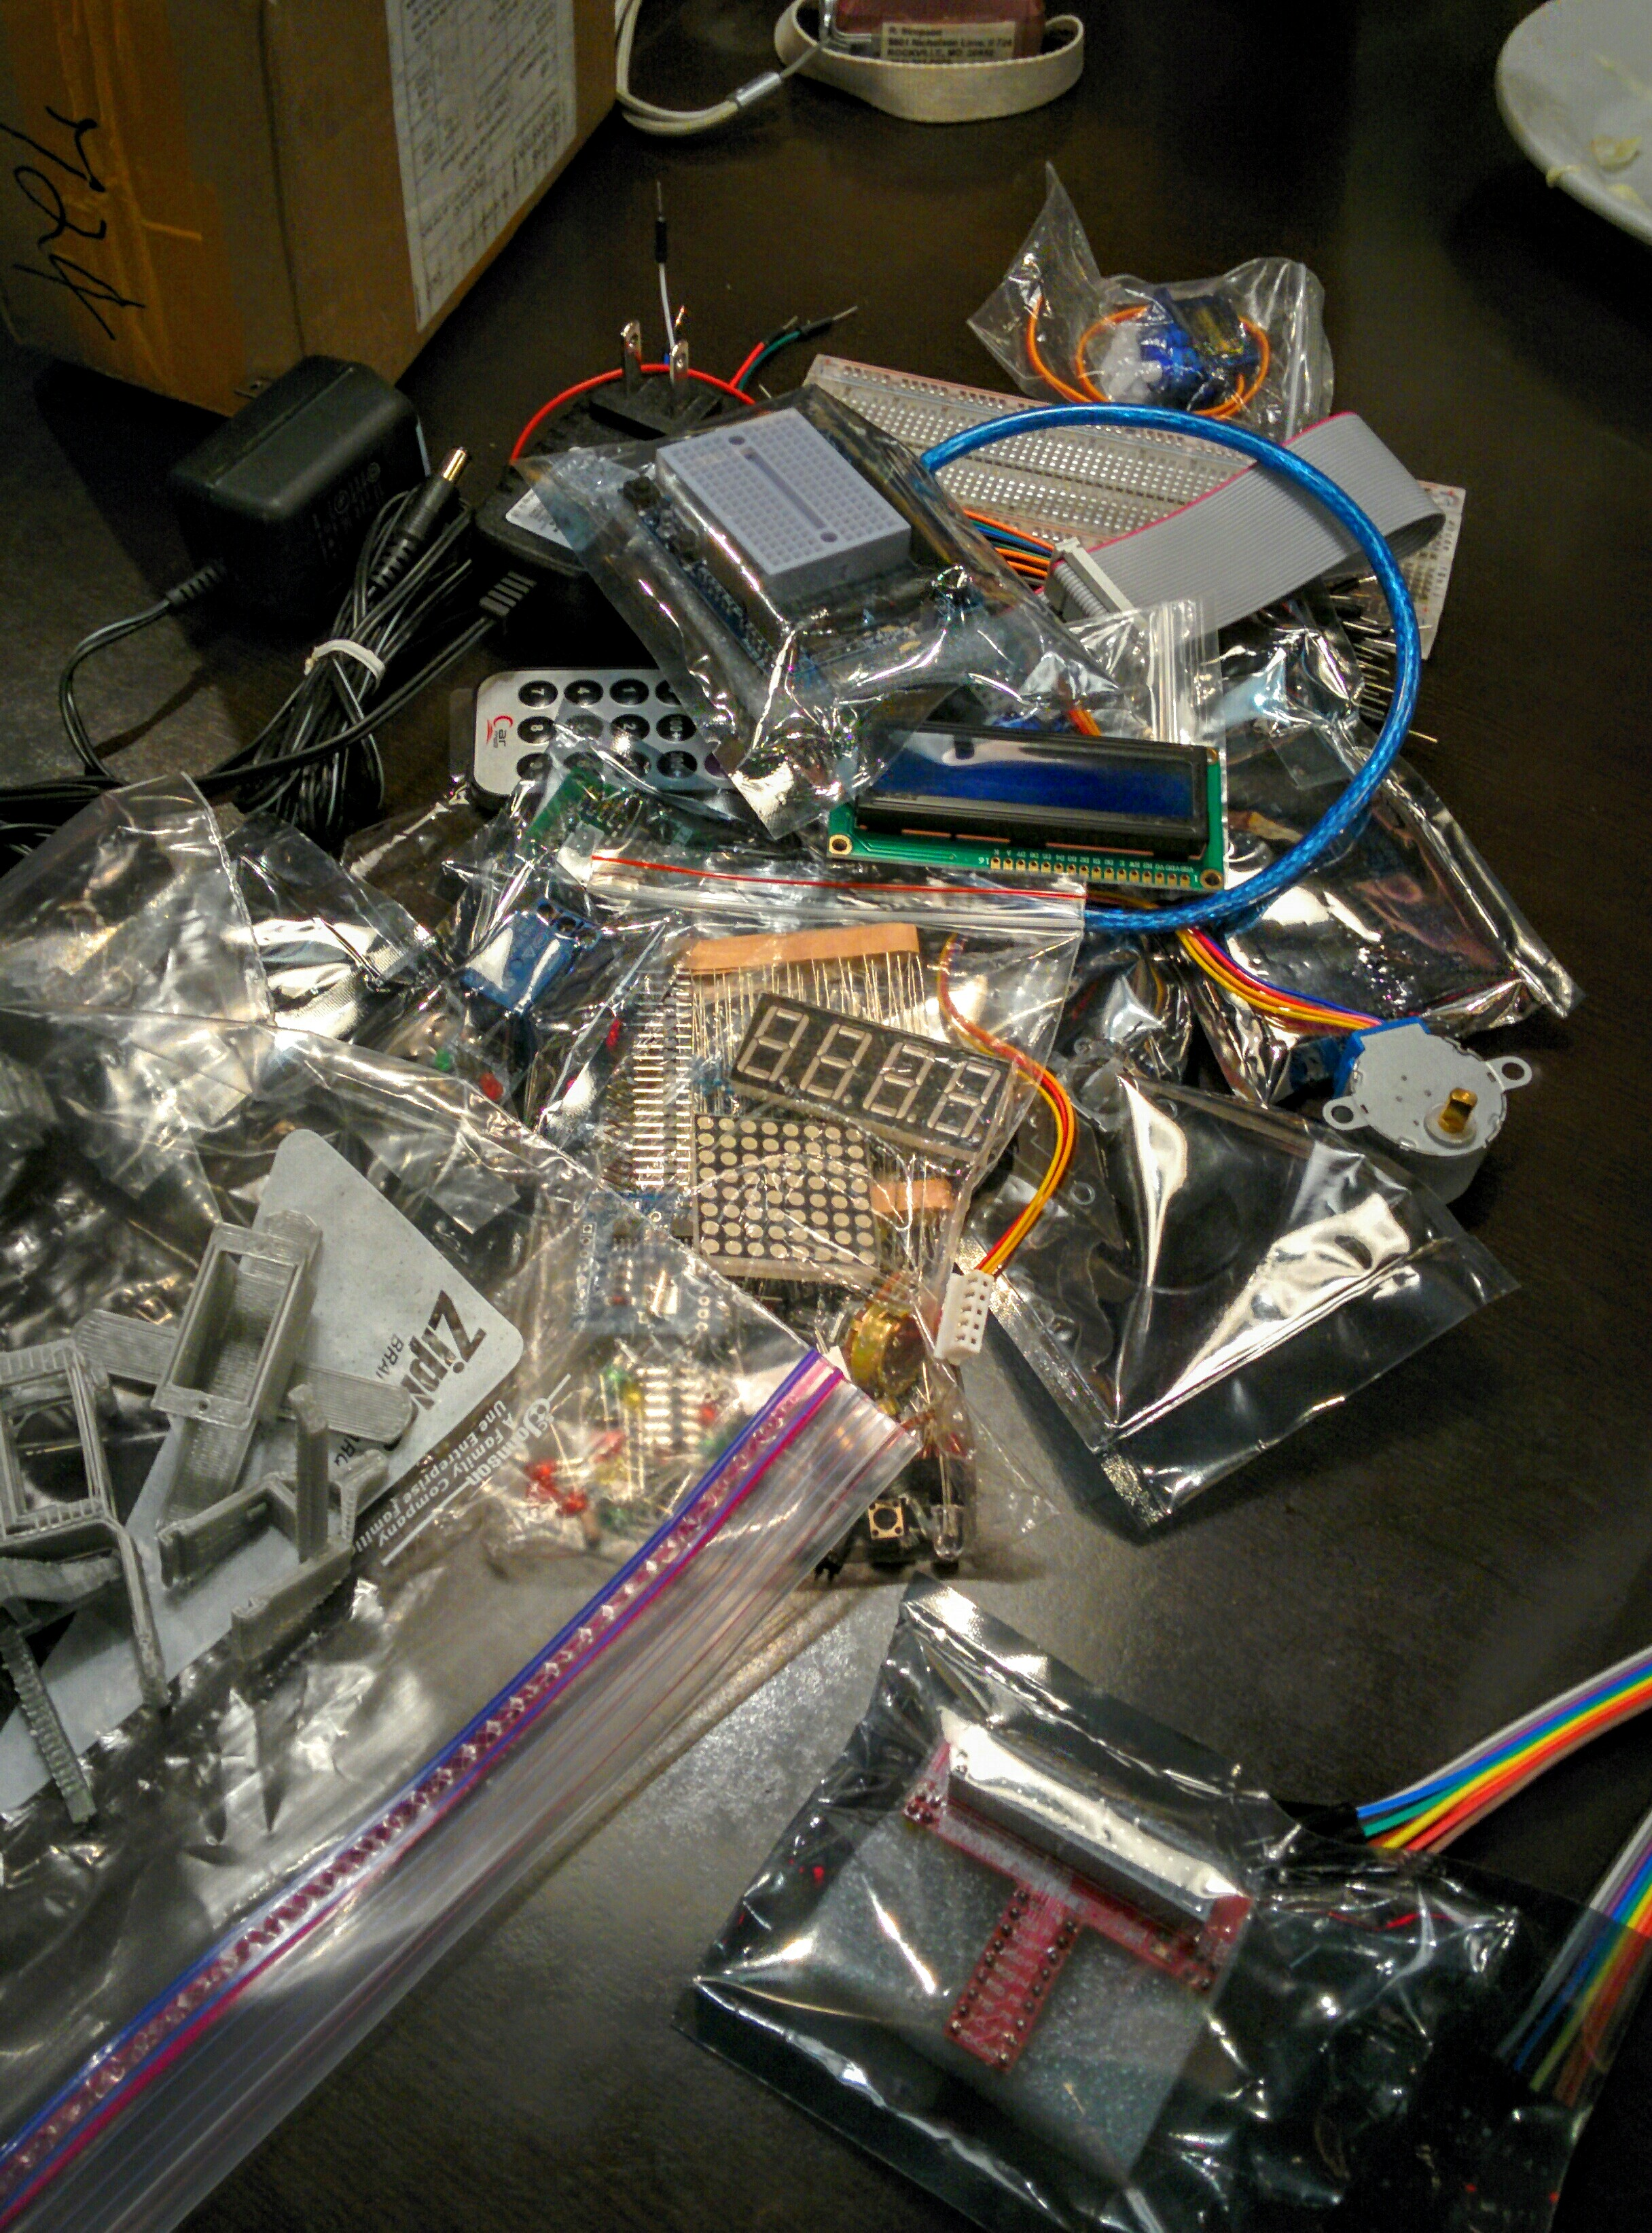

HELLO!
I am Matthew Zamora
I am a co-organizer for MoCo Makers
You can reach me at: matt@mocomakers.com

Slide 3
A PI Cluster using Apache Spark

Slide 4
Theory References
https://databricks.com/blog/2014/01/21/spark-and-hadoop.html
http://aptuz.com/blog/is-apache-spark-going-to-replace-hadoop/
https://en.wikipedia.org/wiki/MapReduce

Slide 5
Your Build References
This one is good though outdated:
http://data-flair.training/blogs/install-apache-spark-multi-node-cluster/
This one is over-simplified but clear: http://data-flair.training/blogs/install-apache-spark-multi-node-cluster/
For the latest Guide see
http://MoCoMakers.com/Blog

Slide 6
Various ways of installing of Spark
https://databricks.com/blog/2014/01/21/spark-and-hadoop.html

Slide 7
Hadoop versus Spark
http://www.datamation.com/data-center/hadoop-vs.-spark-the-new-age-of-big-data.html

Slide 8
Spark Examples
https://spark.apache.org/examples.html

Slide 9

Call for Facilities Sponsor
Typical meetings are 20 people, and we meet once a week, in the evening
MoCo Makers has over 600 members
Robotics, embedded systems, IoT, Software

Slide 10
Local Area Resources
MoCo Makers – www.mocomakers.com
Coder Dojo DC – www.coderdojodc.com
Rockville Science Center - http://rockvillesciencecenter.org/programs/studio-i-makerspace/

Slide 11
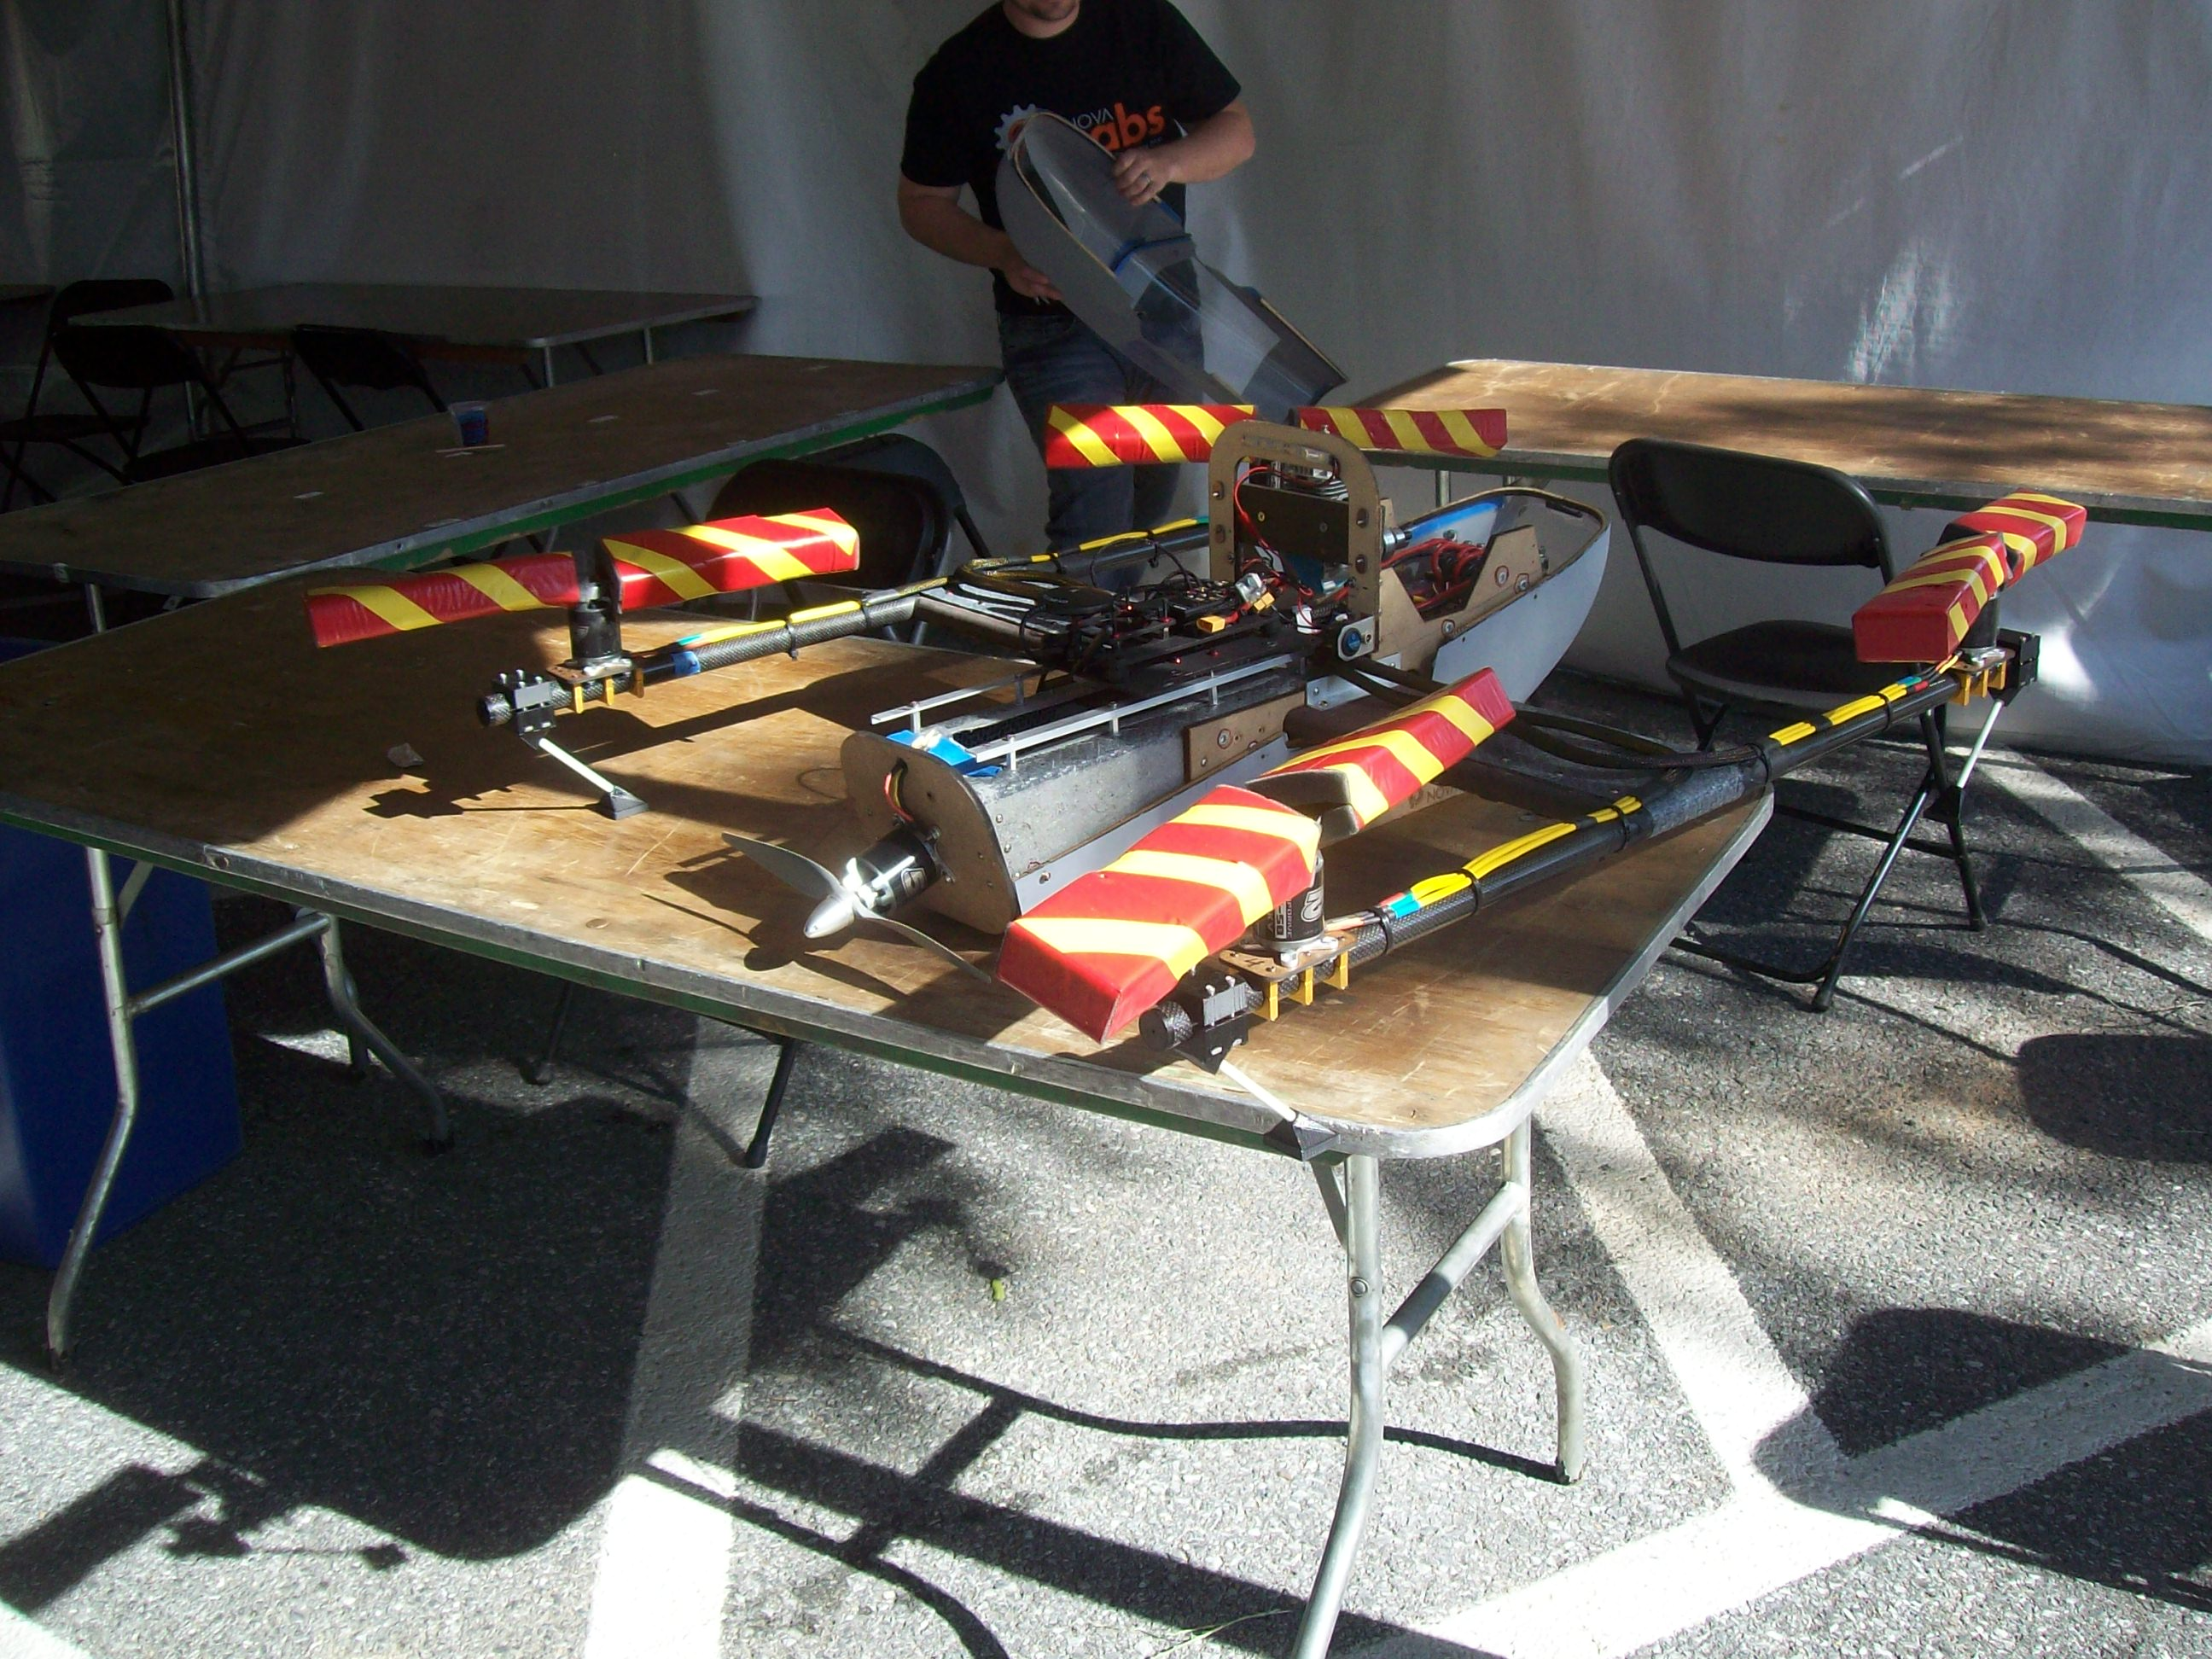
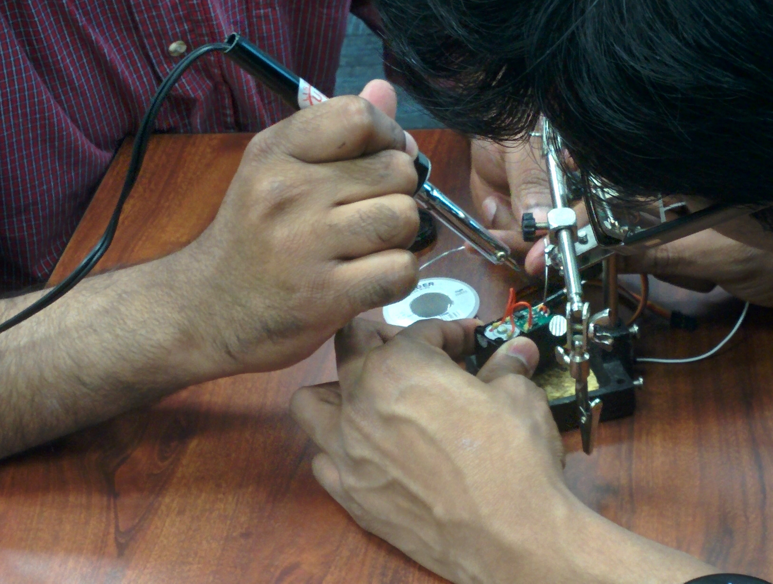
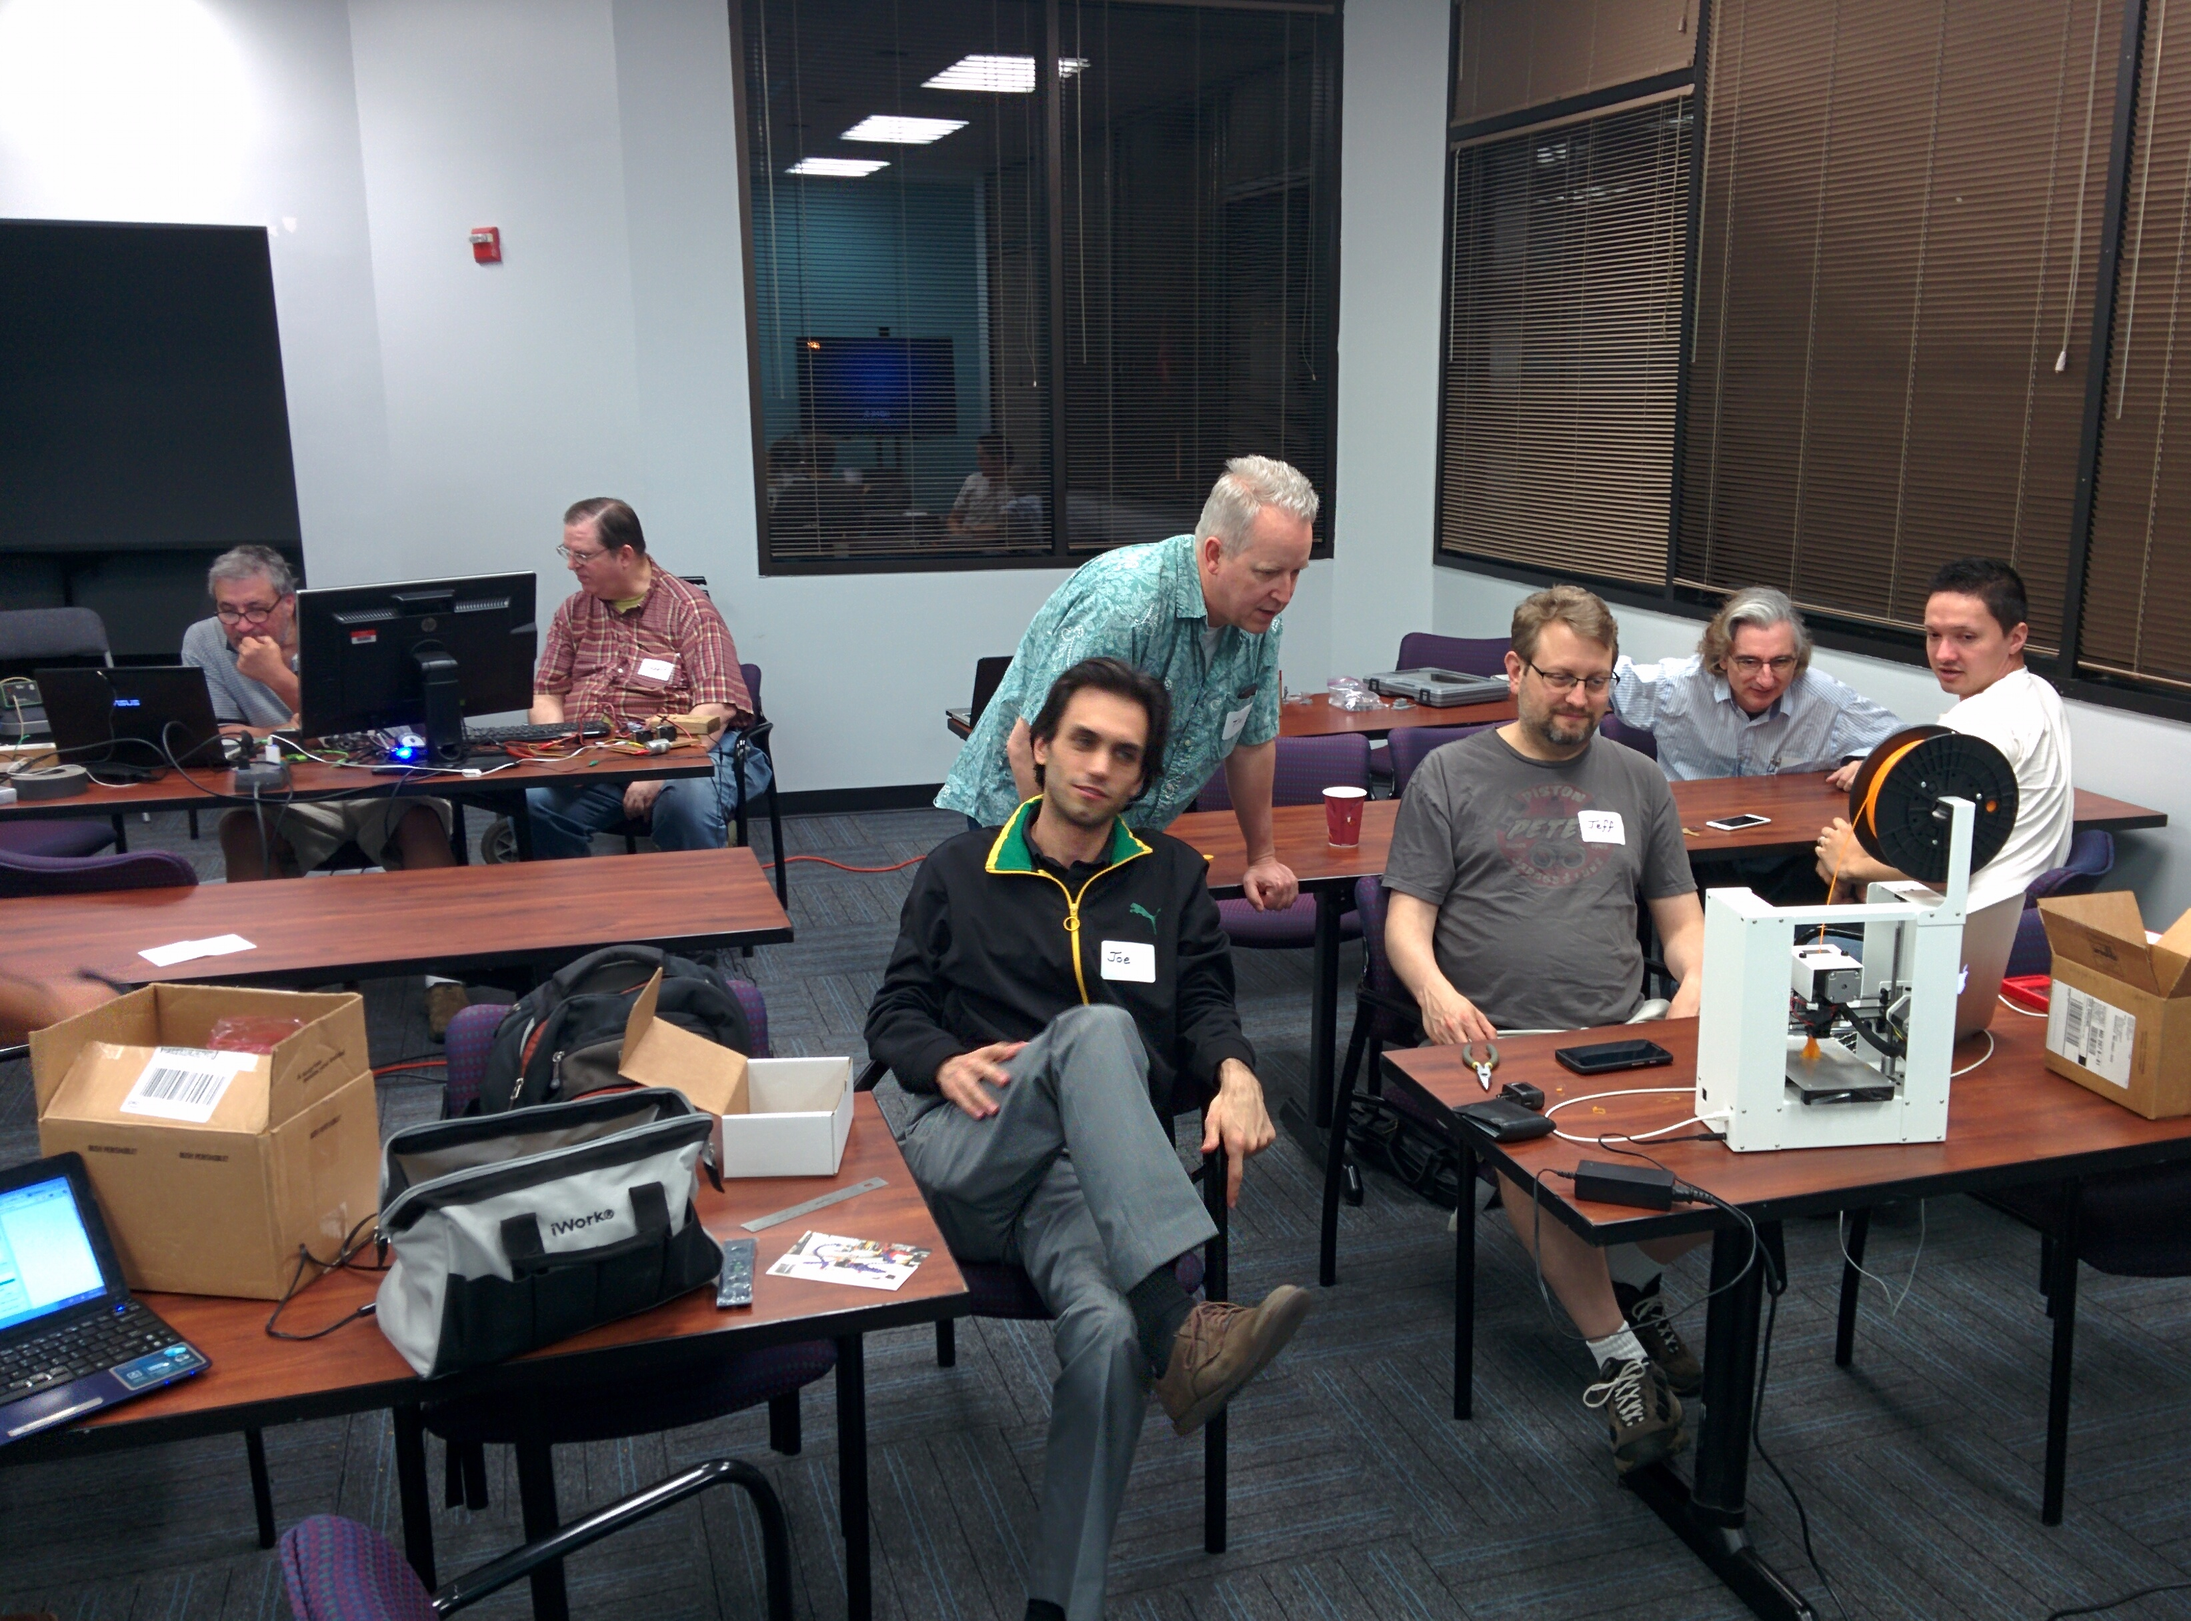
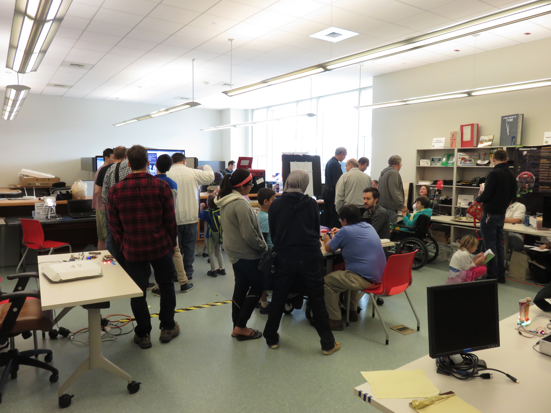

Slide 12
